Slide 1
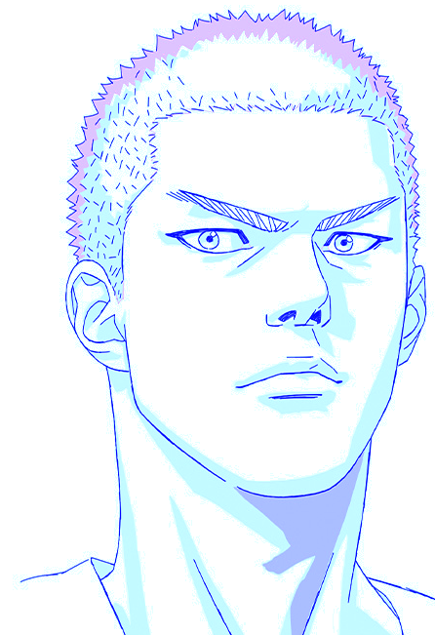
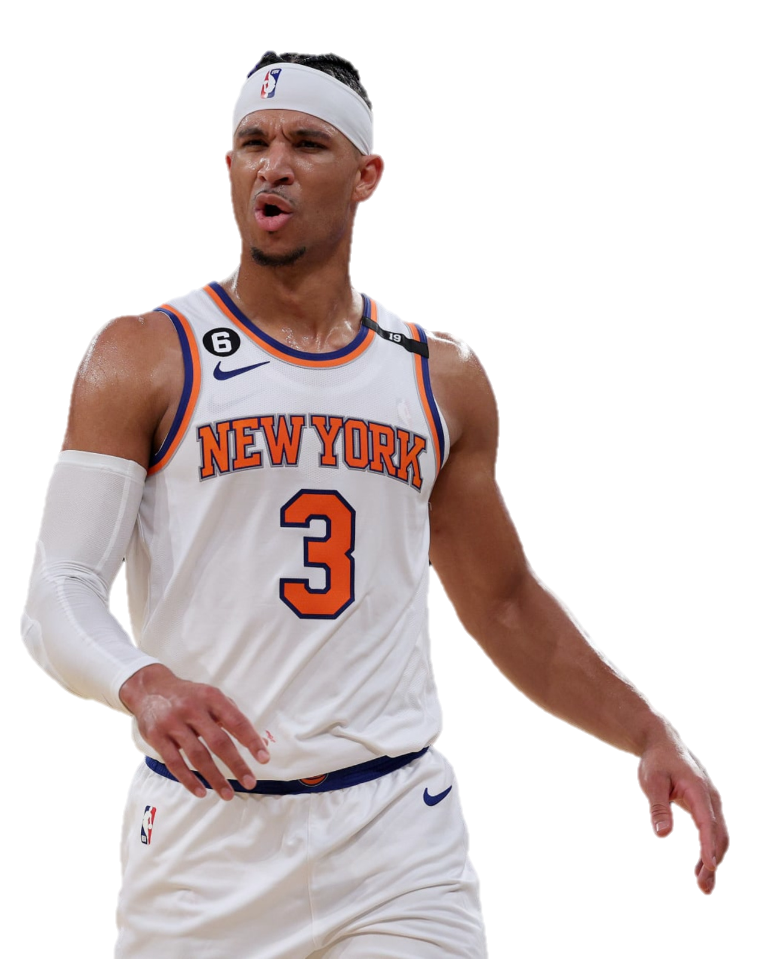
Sakuragi Hanamichi 櫻木花道
Josh Hart
New York Knicks G

Slide 2
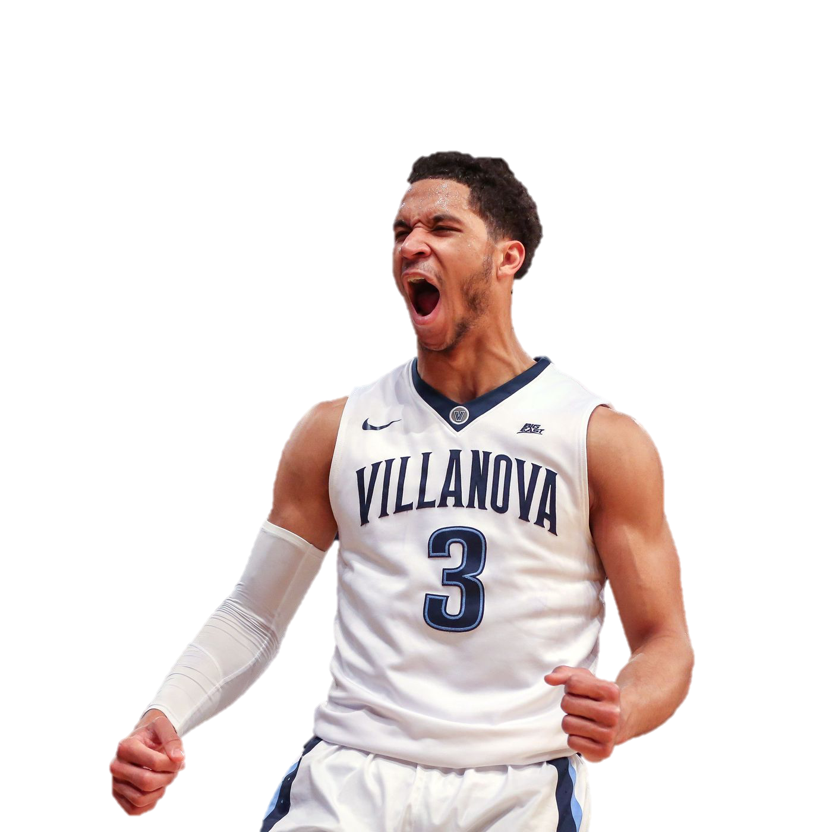
Sakuragi Hanamichi 櫻木花道
Josh Hart
Villanova G

Slide 3

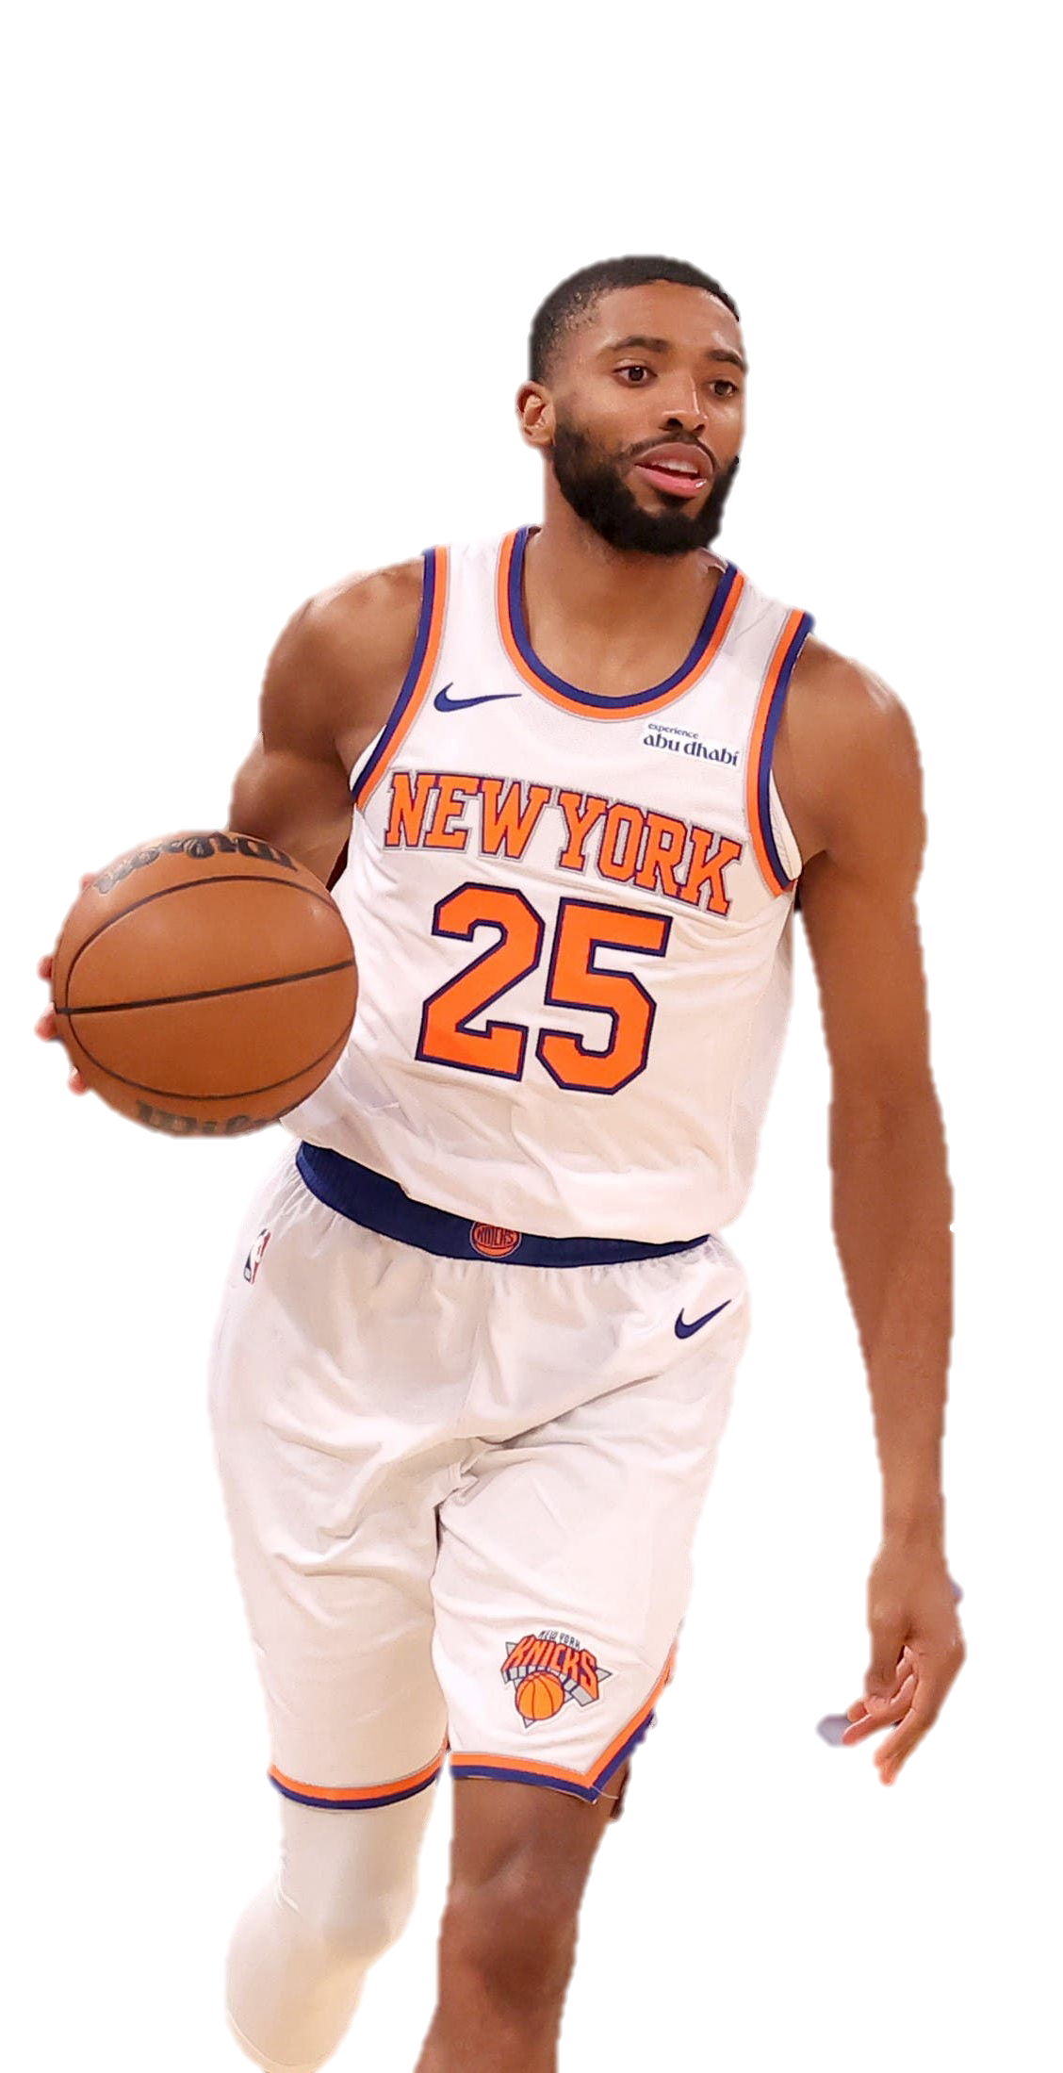
Rukawa Kaede 流川楓
Mikal Bridges
New York Knicks F/G

Slide 4
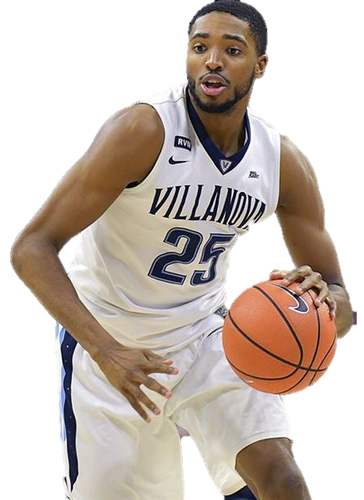
Rukawa Kaede 流川楓
Mikal Bridges
Villanova F/G

Slide 5
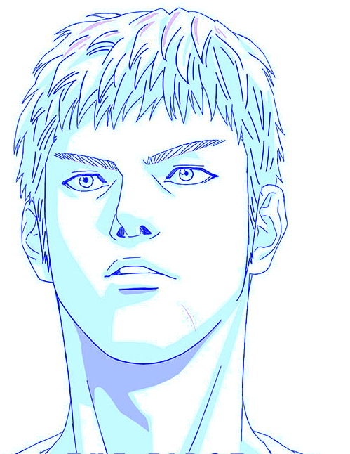
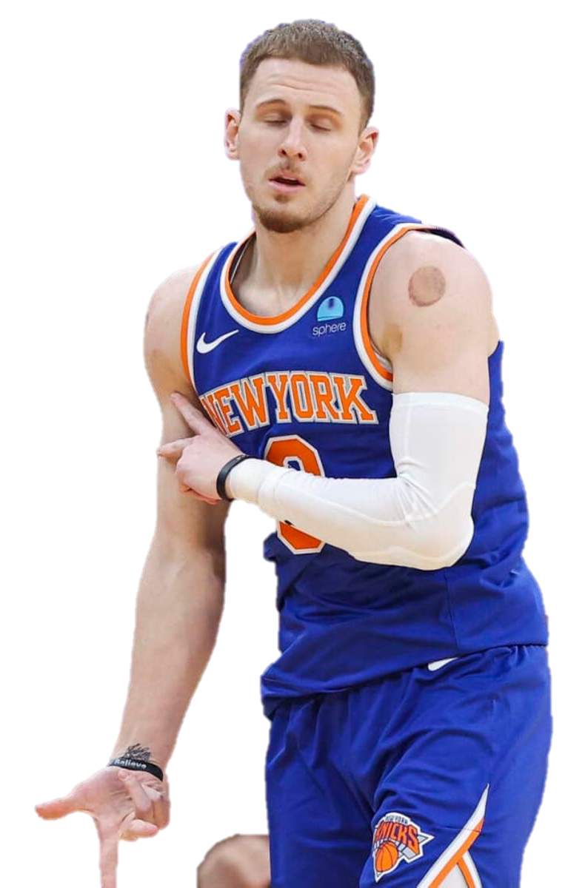
Hisashi Mitsui 三井壽
Donte DiVincenzo
New York Knicks G

Slide 6
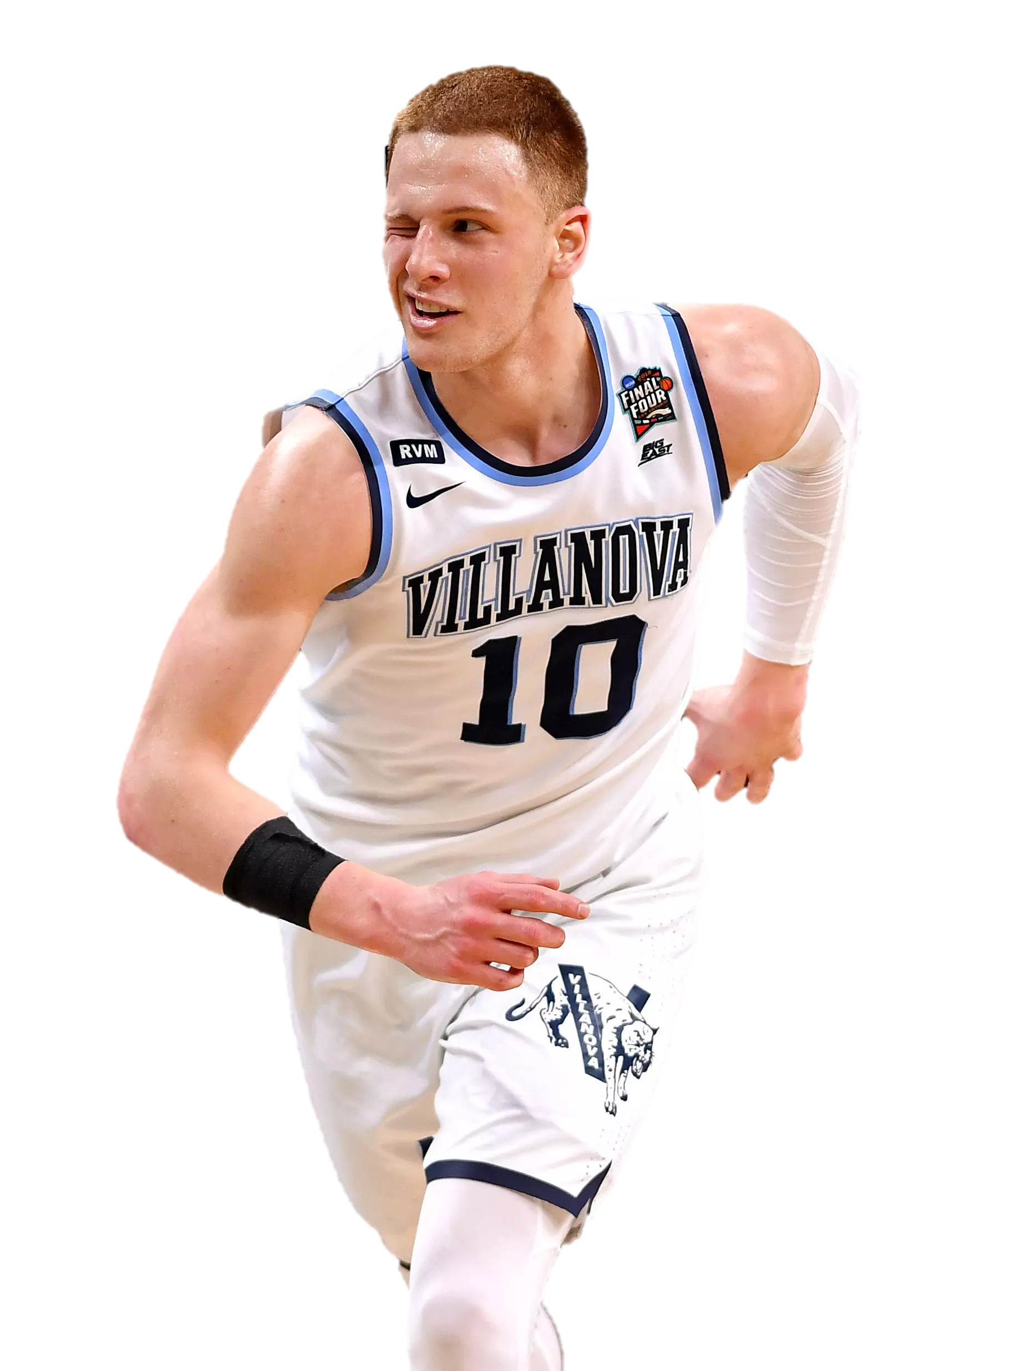
Hisashi Mitsui 三井壽
Donte DiVincenzo
New York Knicks G

Slide 7

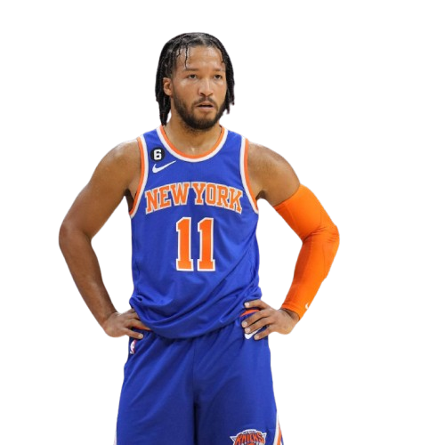
Ryota Miyagi 宮城良田
Jalen Brunson
New York Knicks G

Slide 8
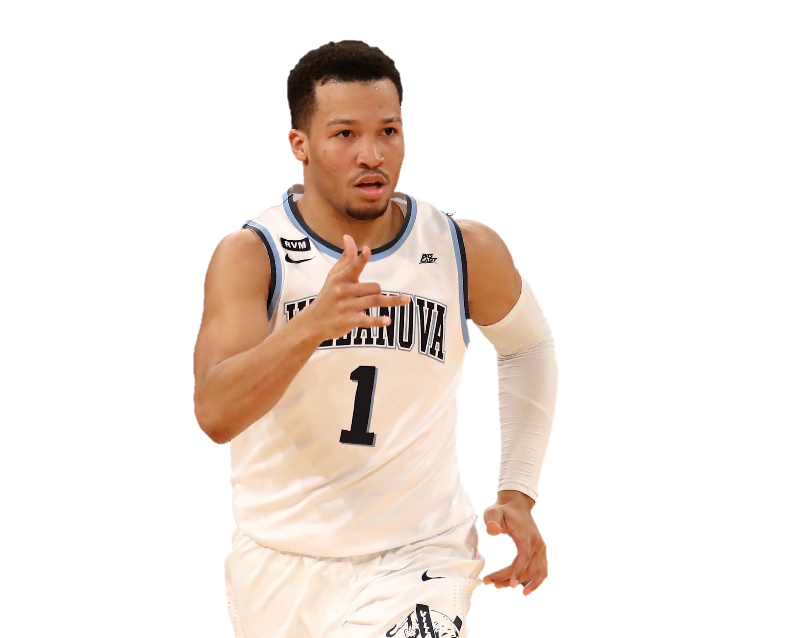
Ryota Miyagi 宮城良田
Jalen Brunson
New York Knicks G

